Slide 1



AMFTRB
2022 Annual Meeting
Options for Occupational & Professional Credential Portability

Slide 2

DORA / DPO Structure
Division of Professions
and Occupations
Other DORA Divisions
Real Estate
Civil Rights
Banking
Financial Services
Securities
Insurance
Consumer Counsel
Conservation
COPRRR
Public Utilities
Licensure and enforcement of 50+ professions,
occupations and businesses, including Six Mental Health Boards
Regulates approximately 500,000 people or
15% of Colorado’s workforce

Slide 3

DPO: What We Do
Inspections
Audits
Education & Outreach
Licensing / Permitting
Investigations
Enforcement
Complaint Resolution
Public Meetings
Notes:
Include here: brief overview of Board vs. Director Model programs

Slide 4

The thing about portability is….
Need to balance concerns for workforce development with main goal of public protection and ensuring licensees meet (and maintain) minimum level of competency
Endorsement
Compacts
Reciprocity & Other
Notes:
- Colorado has traditionally been seen as a “light touch” regulatory environment

Slide 5

Endorsement: Pre-2020
Available for (almost) every profession regulated by DPO
Process for licensees from one state to, essentially, transfer their credential to Colorado
Applicants have to show “substantially equivalent experience and credentials” to qualify for endorsement
Notes:
Prior to 2020, each profession was governed by its own endorsement statute, and each program area was authorized to define, through rule, “substantial equivalency”

Slide 6
Endorsement: Pre-2020
Prior to 2020, each profession was governed by its own endorsement statute
Each Board/program area was authorized to define, through rule, “substantial equivalency”

Slide 7
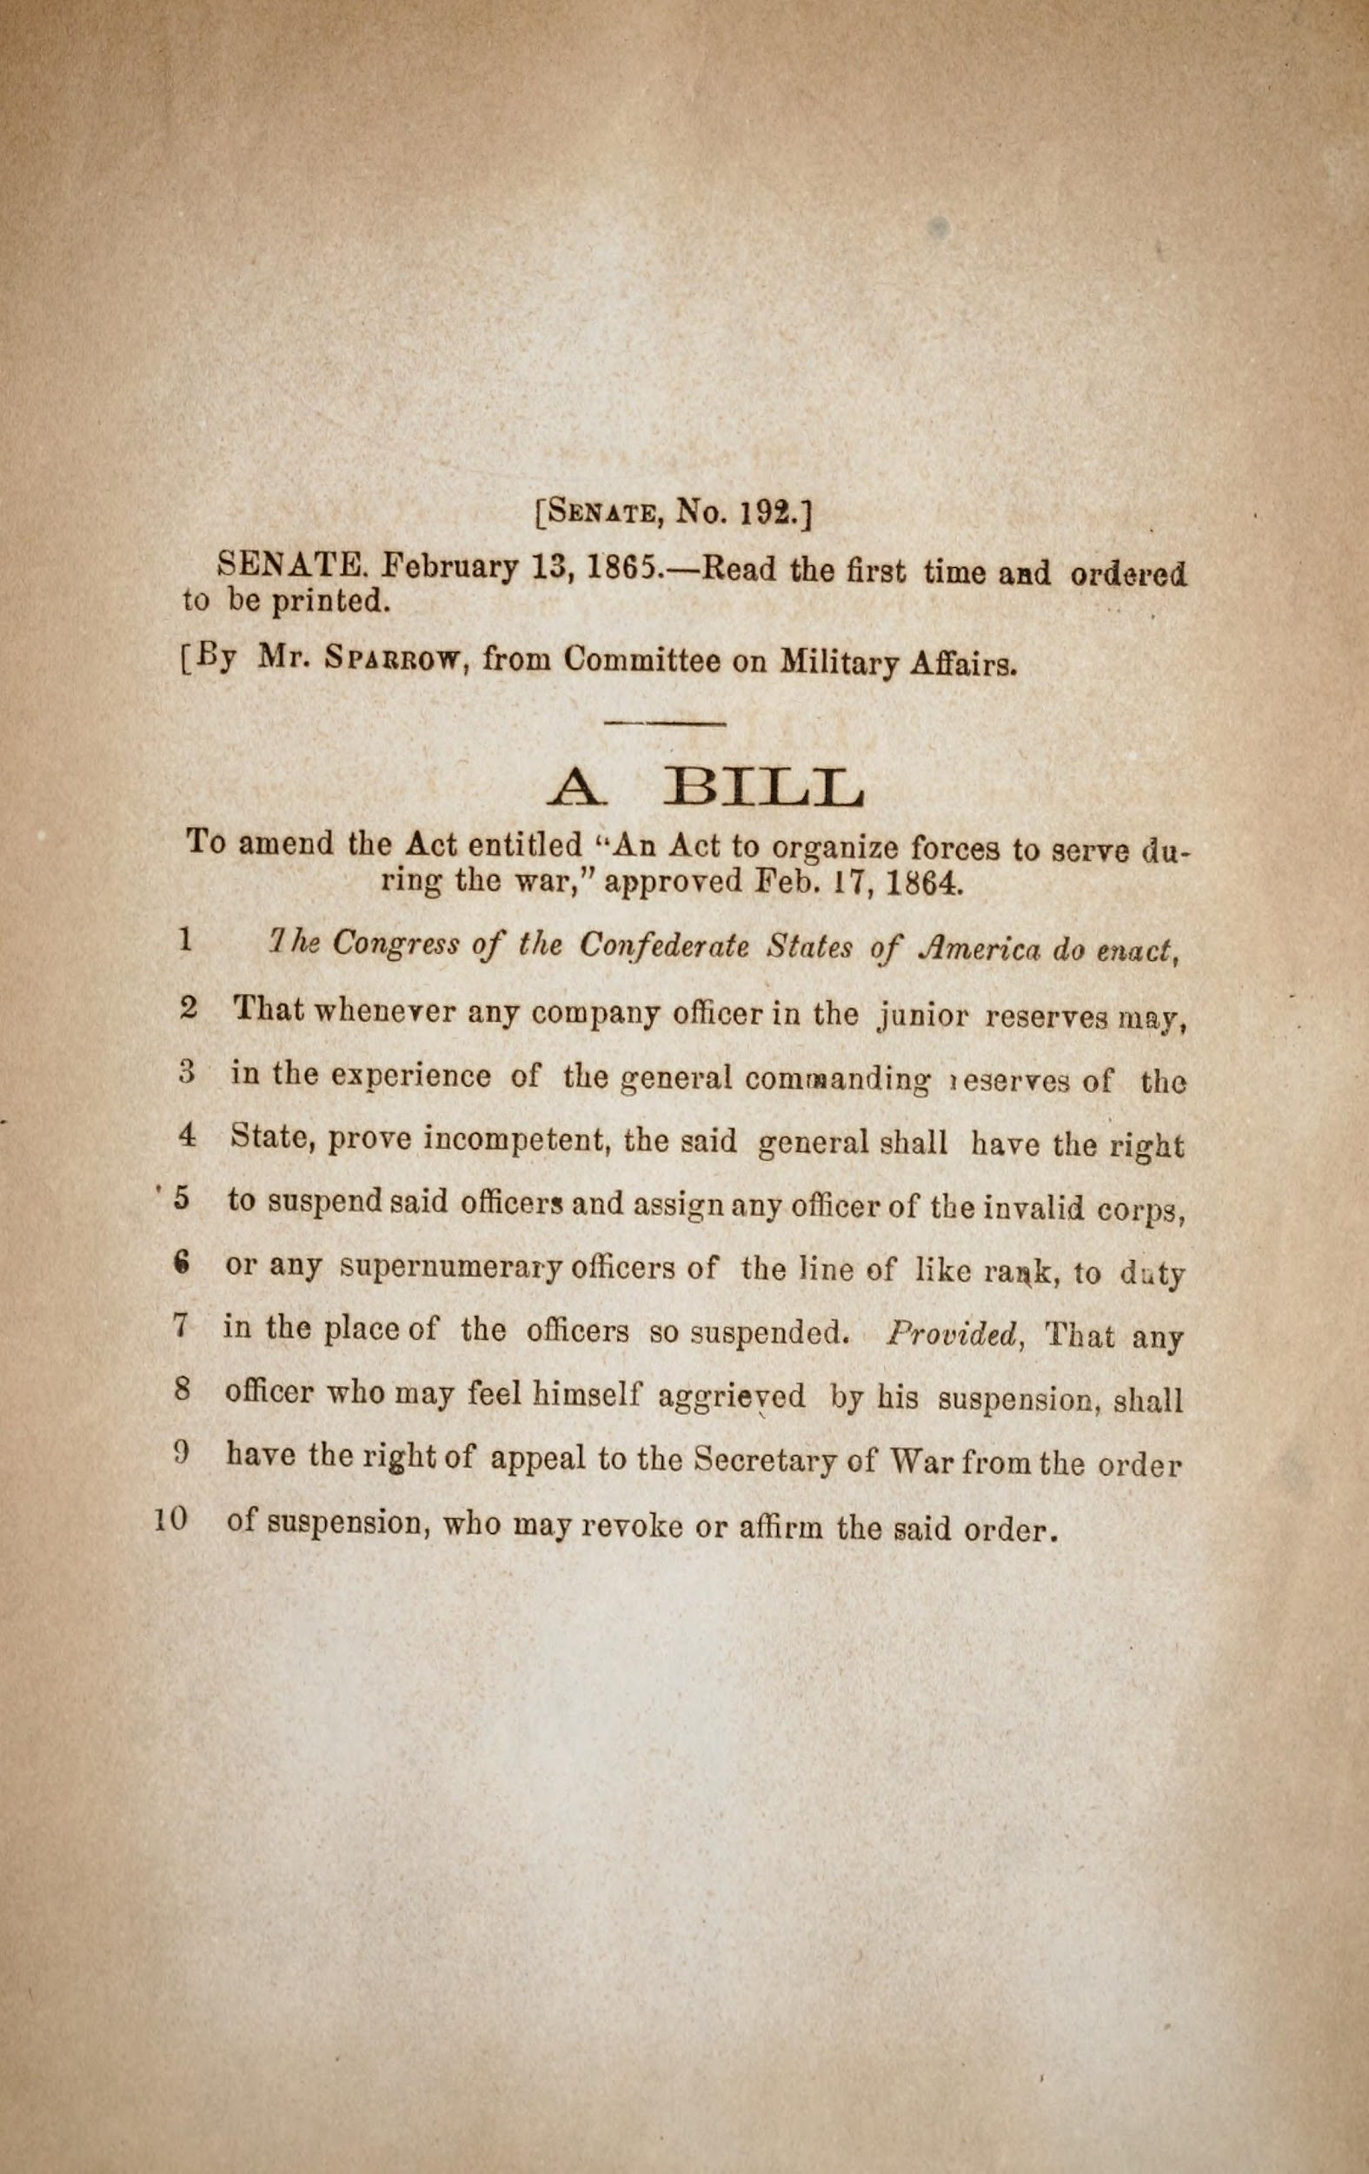
Endorsement: Changes Moving Forward
2020 legislative session: the Colorado General Assembly passes HB20-1326
Exemption for certain professions including:
  AES
  Tramway
  Combative Sports

Slide 8
Endorsement: Portability Program
Standardized requirements for endorsement:
Duly licensed in good standing in another state or US jurisdiction
Submission of satisfactory proof of substantially equivalent experience or credentials
Not committed an act that would be grounds for discipline under the applicable practice act

Slide 9
Endorsement: Portability Program
Standardized requirements for endorsement (cont’d):
Payment of applicable fees
Compliance with other applicable requirements, including passing an exam as required by the relevant practice act

Slide 10
Endorsement: Portability Program
Endorsement under the portability program may be denied under certain circumstances
Maintains authority to specify by rule what “substantially equivalent credentials and experience” means in the context of a particular practice act
Notes:
Circumstances for denial:
If approving the endorsement would violate an existing compact or reciprocity agreement, or
If regulator demonstrates that the applicant lacks substantially equivalent experience or credentials, or has committed an act that would be grounds for disciplinary action under the applicable practice act

Slide 11

Portability Program: Looking Ahead
2022 legislative session: Colorado General Assembly passes SB22-116
Allows endorsement based on applicable Military Occupational Specialty
Can endorse if applicant has, for at least one year, held a license in another jurisdiction with a scope of practice substantially similar to the scope of practice for the profession in Colorado
Notes:
- Scope of practice rather than education/experience/credentials
- 116 is currently being implemented by the programs within DPO
- Bottom line on Portability Program:
Clarified and streamlined the laws dealing with credential portability - increase regulatory efficiency and effectiveness by making the relevant statutes easier to understand for those seeking licensure while also allowing for tailoring of the individual programs to fit the needs of diverse and varied regulated professions
Created a (virtually) automatic pathway to licensure for applicants who meet the portability program requirements

Slide 12
  Portability Program: Improvements & Successes
Reduced Licensing Timelines
Improved Efficiency
Remove Unnecessary Requirements
Consolidate Statutory Provisions
Notes:
Examples of unnecessary requirements for endorsement: active practice in the profession for X of the last Y years

Slide 13
  Portability Program: Improvements & Successes
Improved application processing timelines
Notes:
And during a pandemic, no less!!

Slide 14

Portability in Colorado: Military Spouse Licenses
HB20-1326 also expanded Colorado’s approach to licensing spouses of active-duty military personnel via the new Military Spouse Licenses

Slide 15
Portability in Colorado: Military Spouse Licenses
Prior to HB-1326, Colorado provided an exemption to professional licensure for military spouses in the form of a one-year license-free period, so long as certain conditions were met
This scheme created problems for professionals and employers, particularly in healthcare, that kept many military spouses from actively practicing under the exemption
Notes:
Examples of problems: difficulty in verifying an out-of-state license; difficulty obtaining malpractice insurance

Slide 16
Portability in Colorado: Military Spouse Licenses
HB20-1326 replaced the one-year exemption with a no-cost, three-year, non-renewable credential
Official license in their profession, that is easily verifiable by employers and the public
To obtain a Military Spouse License:
Hold a license in good standing from another state or US jurisdiction
Apply to the Division
Notes:
Military Spouse = legal spouse of an active-duty military member who is stationed in Colorado on official military orders

Slide 17

Portability in Colorado: Reciprocity Agreements
Bilateral agreement between two states; typically allow for expedited licensure - a compact in miniature
One profession at a time
Tailored to the needs of each party state
Not widely used in Colorado
Notes:
Not widely used in Colorado: only electricians have one, and the midwives practice act actually explicitly forbids the use of reciprocity agreements

Slide 18

Portability in Colorado: Reciprocity Agreements
Example Reciprocity Agreement:
National Electrical Reciprocal Alliance (NERA)
If the applicant meets the NERA requirements, the Colorado Electrical Board will issue a certificate without written examination upon application and payment of application fees
Notes:
Alaska, Arkansas, Idaho, Iowa, Massachusetts, Minnesota, Montana, Nebraska, New Hampshire, New Mexico, North Dakota, Oklahoma, South Dakota, Utah, Wyoming
NERA Requirements: Applicable only to journeyman electrical licenses: (1) hold a journeyman certificate or master electrician certificate that is current, active, and in good standing allowing the holder to work as a journeyman electrician in the licensing state; (2) gained their license via a state-administered examination; and (3) have held the license for a least 1 year
Reciprocity Agreements are essentially a compact with less structure/less centralization - in the case of NERA, for example, it really just sets the parameters for two states to enter an agreement directly between each other, rather than joining a compact - no compact commission, for example

Slide 19

Portability in Colorado: Compacts
Multilateral agreements between (typically) 10 or more states
Creates a separate legal entity as an instrumentality of the member states (compact commission)
Notes:
Though similar to reciprocity agreements, compacts are different in key way - first and foremost, they are multilateral rather than bilateral

Slide 20
Portability in Colorado: Compacts
Full legal and regulatory authority to act on behalf of the member states in relation to the compact
Compacts and commission rules are binding on the members and supercede conflicting state laws
Notes:
the compacts specifically give the commissions rulemaking authority, the outcome of which is likewise binding on the member states - important to be involved in the rulemaking process!

Slide 21
Portability in Colorado: Compacts
Colorado is a member of the following Compacts:
Medical
Nursing (eNLC)
Psychology
Occupational Therapy
Physical Therapy
Audiology/Speech-language Pathology
Licensed Professional Counselor
Notes:
Additional compacts currently under development include APRN and barbers/cosmetologists

Slide 22

Interstate Licensure Compacts - Food for Thought
Main consideration: they are all (at least slightly) different!
Advantages of Compacts:
  Interstate uniformity without federal intervention
  Maintains collective state sovereignty
  Greater number of member states means greater portability options for licensees
Notes:
some, like the Medical compact, essentially just set up an expedited endorsement process that allows applicants to skip most of the original licensure process (e.g. primary source verification and USMLE). Others are geared much more toward facilitating telehealth (e.g. the Psychology Interjurisdictional Compact allows for unfettered telepsychology for compact privilege holders, while continuing to limit the number of days a licensee can physically work in another compact state). Other compacts - eNLC, OT, ASLP - operate more along the lines of what someone might typically think, e.g. allows a licensee in one member state to practice their profession in another member state under a “privilege to practice” based on holding a single license in their “home state”
Advantages:
Maintain sovereignty -- states free to join and leave as their legislatures see fit vs. federal law that is universally applicable regardless of whether an individual state may or may not agree with that law
Allows the member states to determine the appropriate educational requirements, training requirements, etc.- rather than the federal government
Could even have “competing” compacts in the same profession if the differences were big enough!
Multilateral nature of compacts allows for greater flexibility in portability vs. endorsement or reciprocity agreements, especially as a particular compact becomes more widely adopted across the states
Existence of a compact in a profession can help standardize educational requirements in those states as they begin to “teach to the compact”

Slide 23

Interstate Licensure Compacts - Food for Thought
Disadvantages of compacts:
  Setup of new commission can be costly and time-consuming
  Lack of familiarity with the compact mechanism - lots of misunderstandings from both administrators and licensees
  Lack of trust in other states’ regulatory processes
  Loss of individual state sovereignty
Notes:
Major costs include creation/adoption of a centralized data system
Misunderstandings include: what to report, to whom, and when? Can’t I just start working in another state?? Do I really have to learn the scope of practice in each state??

Slide 24
Portability in Colorado: Other Options
Colorado has several additional portability mechanisms outside of the endorsement, reciprocity agreements, and compacts
Nurse & Nurse Aide Practice Act
Temporary Practice Provisions in Mental Health Practice Act
Temporary Practice Provisions in Medical Practice Act
Notes:
MH 20 day exemption = 12-245-217(2)(e)
Med temp allowance = 12-240-107(3)(b)

Slide 25
Portability in Colorado: Other Options
Are performed within the scope of the person’s license
The Colorado Mental Health Practice Act allows a licensee from another state to perform activities or services in Colorado if the services rendered:
Do not exceed 20 days per year in the state
Are not otherwise in violation of the Practice Act
Give proper notice that they are not licensed in Colorado
Notes:
The Colorado Medical Practice Act - which governs physicians, physician assistants, and anesthesiologist assistants - has a similar exemption allowing for “occasional rendering of services” in Colorado if the physician meets certain requirements
Med temp allowance = 12-240-107(3)(b)
(3) A person may engage in, and shall not be required to obtain a license or a physician
training license under this article 240 with respect to, any of the following acts:
(b) The occasional rendering of services in this state by a physician if the physician:
(I) Is licensed and lawfully practicing medicine in another state or territory of the United
States without restrictions or conditions on the physician's license;
(II) Does not have any established or regularly used medical staff membership or clinical
privileges in this state;
(III) Is not party to any contract, agreement, or understanding to provide services in this
state on a regular or routine basis;
(IV) Does not maintain an office or other place for the rendering of such services;
(V) Has medical liability insurance coverage in the amounts required pursuant to section
13-64-302 for the services rendered in this state; and
(VI) Limits the services provided in this state to an occasional case or consultation;

Slide 26

Questions?

Slide 27
Thank you!

