Slide 1


July 2021-June 2022

Slide 2

Agenda
Exam Information
DEI Efforts
New Developments Highlights
State Board Information

Slide 3

EXAM INFORMATION

Slide 4
Domain Information
Domains | Domain percentage | # of items per domain on 180 item examination
The Practice of Systemic Therapy | 23.3% | 42
Assessing, Hypothesizing, and Diagnosing | 13.8% | 25
Designing and Conducting Treatment | 12.1% | 22
Evaluating Ongoing Process and Terminating Treatment | 17.5% | 31
Managing Crisis Situations | 14.4% | 26
Maintaining Ethical, Legal, and Professional Standards | 18.8% | 34
*based on 2021 JTA results

Slide 5
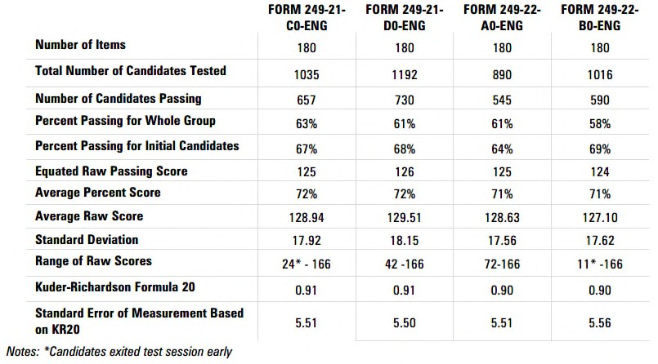
Psychometric Characteristics

Slide 6
Trends: Pass Rates
Pass Rate
90%
80%
70%
60%
50%
40%
30%
20%
10%
0%
2019-A 2019-A-R 2019-B 2019-C 2019-C-R 2019-D 2020-A 2020-B 2020-C 2020-D 2021-A 2021-B 2021-C* 2021-D 2022-A 2022-B
Whole Initial Repeater

Slide 7

ADA Test Accommodations: Frequent Requests
Extra time
Large text printed test booklet
Zoom text on computer
Reader
Scribe
Test separately
Frequent breaks

Slide 8

English Language Leaners (ELL)
Are able to request additional time to take the examination
Is an arrangement; not an ADA accommodation
Is a state decision; must be approved by the state board
Use of ELL is reported on candidate score reports, state board reports, AMFTRB reports; and score transfers between states
The process and the form used for ELL can be found in Appendix K
List of states allowing or prohibiting on page 26

Slide 9
Trends: Test Accommodations (ADA) and English Language Learners (ELL)
7.00%
6.00%
5.00%
4.00%
3.00%
2.00%
1.00%
0.00%
Jul 2015 - Jun 2016 Jul 2016 - Jun 2017 Jul 2017 - Jun 2018 Jul 2018 - Jun 2019 Jul 2019- Jun 2020 Jul 2020- Jun 2021 Jul 2021- Jun 2022
ELL ADA

Slide 10

DEI EFFORTS

Slide 11
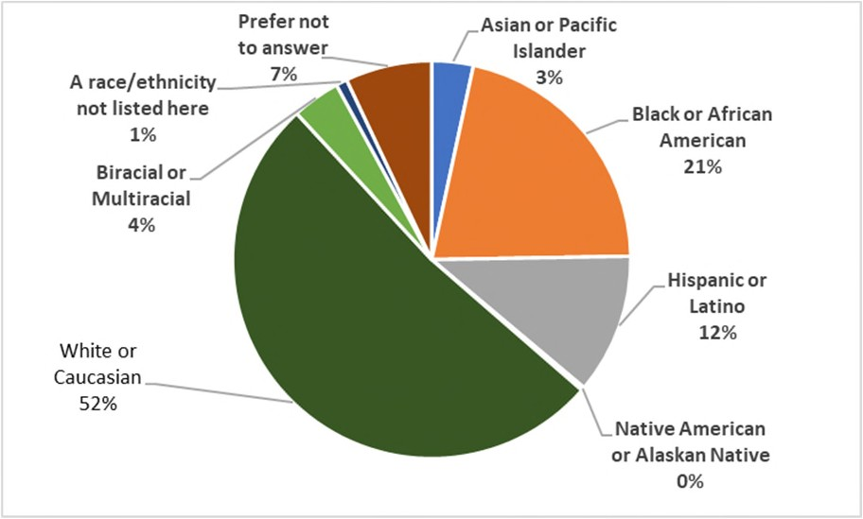
Revised Optional Demographic Questions
CANDIDATE GENDER
CANDIDATE ETHNICITY
Non-binary
1%
Trans Woman
0%
Trans Man 0%
Other Prefer not to
1%
answer
2%
Man
30%
Woman
66%
(JANUARY – JUNE 2022)

Slide 12
Weaving Diversity Training Throughout Test Development Processes
AMFTRB
  Recruiting diverse SME panels
  Training SMEs
  Requesting test questions from groups/SMEs who express interest in DEI and multicultural topics
PTC
  Training staff
  Committee work
  Multicultural staff

Slide 13

Post-Exam Analyses
Review item comments and feedback
Review aggregate demographic data
Perform DIF analyses

Slide 14

Differential Item Functioning (DIF)
What is it?

Slide 15
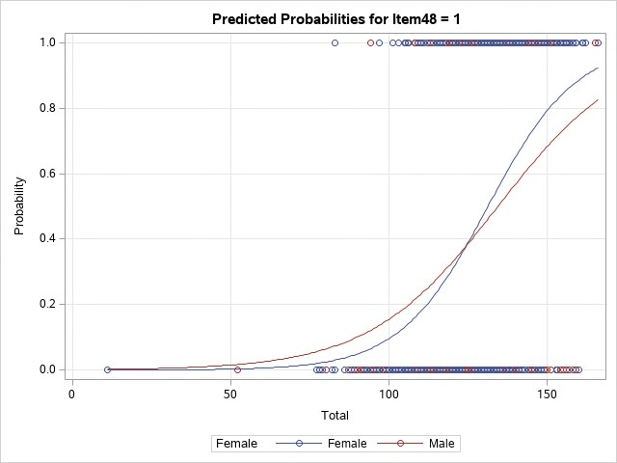
Differential Item Functioning (DIF)

Slide 16



DIF Process on Each Exam Form
Review
Review flagged items
Change
Make changes as needed
Monitor
Monitor for multiple flags

Slide 17
Alternatives to Written Exams
 | Current MCQ Exam | Portfolios
Administration | Standardized: all candidates test in comparable test centers on the same test platform | Varies by location and supervisor
Scalable/ Portable | Scalable Portable across all states | Hard to scale Location dependent
Scoring Method | Computer Automated processing with MCQ answer key | Manual, human raters Requires clear rubrics, procedures, and criteria for scoring by judgment Desired to have multiple raters
Timing of Reports | Issued within 4 weeks of testing period | Can be issued months after as multiple raters need to do scoring first
Cost to Create | Cost effective | Cost prohibitive
Special Requirements | Requires item writing training for SMEs Requires candidates to go to test center to take computerized exam | Introduces rater bias: intensive rater training required to reduce rater bias Technical review to separate administrative requirements from the rating process Requires dedicated mentors/ supervisors willing to work with applicant long-term

Slide 18

NEW DEVELOPMENT HIGHLIGHTS

Slide 19

Responding to Increased Candidate Test Center Violations
Increase in prohibited phone use by candidates and test center violations
revised Test Center Security Agreement developed and revised policies
updated Candidate Handbook and Candidate Scheduling Authorization with new prohibited cell phone use language
encouraged candidates to talk with proctors

Slide 20
Remote Proctoring Considerations
 | Test Center | Live Remote Proctored Exam
ADA Accommodations | Yes; all | Extra time and private room only
Breaks Allowed | Yes; timer runs | Possible with sectioned exams; candidates need to go through room scan upon each return
Equipment Needed | None; provided at test center | Candidate provides their own laptop or desktop computer to take the exam. The computer must have: Webcam Microphone Secure, reliable internet
Testing Space Needed | None; provided by test center | Candidates must test alone at a desk or table in a room with a door and no distractions or interruptions. Other people or pets are not permitted in your testing area.

Slide 21
Utilizing Data in Different Ways
Implemented Rasch Modeling during Standard Setting
to leverage Angoff standard setting process with empirical data
Discussing workshops to help states use data; use portal; respond to questions

Slide 22


STATE BOARDS

Slide 23



State Codes
State logs in to PTC portal to get unique code
State logs in to PTC portal to get unique code
State gives unique code to candidate
Candidate uses unique code during exam application

Slide 24
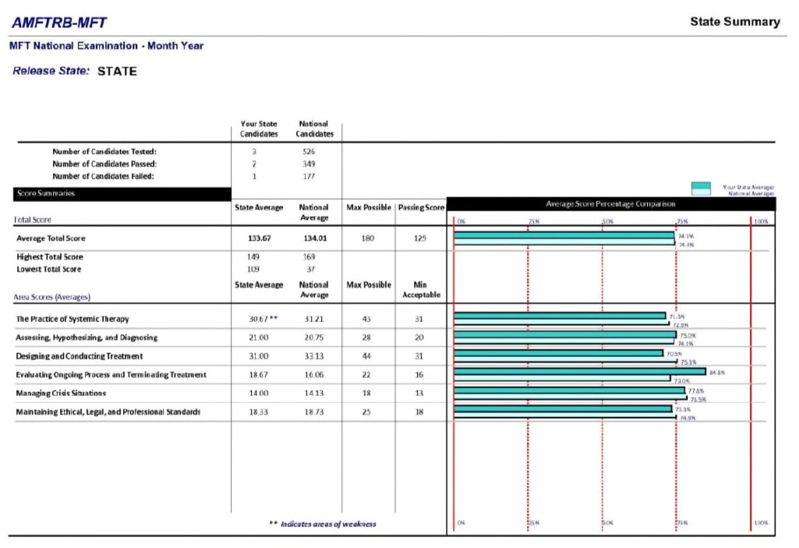
State Summary Report

Slide 25

Questions about Reports
Contact PTC directly with issues retrieving reports from portal or questions about locating reports for candidates: Sherry Frier – sfrier@ptcny.com; 212-356-0661
Contact Sherry and Lois directly with change of staff information

Slide 26

Thank You!

