Slide 1
Licensure Portability Considerations
AMFTRB Annual Meeting of Delegates – September 13, 2022
Roger Smith, JD
Director of Government and Corporate Affairs &
General Counsel

Slide 2
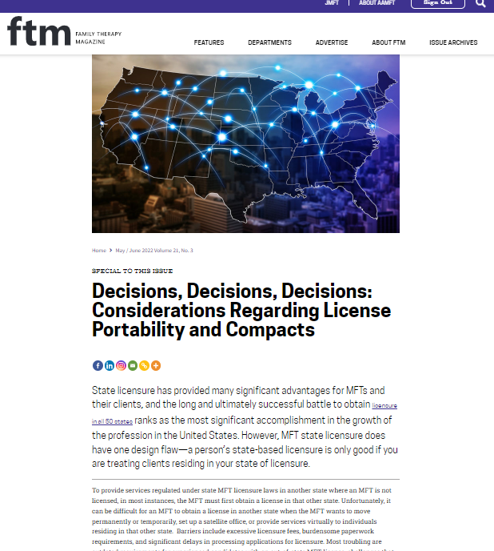
Potential paths for licensure portability
Model laws
Interstate compacts
Other

Slide 3

History
Prior Models: “Substantially Equivalent” standard
MFT Portability Workshop hosted by AMFTRB (2016)

Slide 4
History since 2016 Workshop
AMFTRB Model for Licensure by Endorsement (2017)
AAMFT Portability Survey (2018)
AAMFT Model Portability Law (2019)
COVID-19 Pandemic Flexibilities

Slide 5
History since 2016 Workshop
Advocates for Change:
  Policymakers
  State Elected Officials
  Federal Government (FTC, DoD)
Health Professional Interstate Compacts
  Existing: Nursing, Psychology
  New: Counseling, Social Work,

Slide 6

AAMFT Model MFT Portability
The licensure board shall issue a full and unrestricted license to an applicant to practice as a marriage and family therapist if the applicant:
(1) has a valid and unrestricted license to practice as a licensed marriage and family therapist in another state or territory; and
(2) has completed an application for licensure and paid any required fees.

Slide 7
Model Portability Law Process
Model law development
Strategic targeted lobbying
Adoption and lobbying

Slide 8
Develop the compact language
Public review
Submission and lobbying of compact friendly states
Enaction of compact; launch of compact commission
Continued lobbying and expansion of compact
Compact Process
At this stage, operations for the compact shift to the Compact Commission. Revenues will go to support the Compact Commission, but AAMFT and other MFT stakeholder groups would still be responsible for cost differential and lobbying.

Slide 9

2022 Industry Workforce Study
The electronic survey was distributed via email to 25,879 contacts provided by AAMFT. McKinley initially launched the survey, and AAMFT followed with subsequent reminder emails. The survey was fielded over 15 days from June 7, 2022 to June 22, 2022. In total, 3,108 respondents completed or partially completed the survey questionnaire for a total response rate of 12%. This is in line with other surveys McKinley Advisors has conducted as well as response rates in the field of market research. For example, Pew Research, which conducts major opinion polls regularly, has historically received responses rates between 5% and 15%. Typical response rates have continued to decline with the most recent response rates averaging 6%. Notwithstanding, this electronic survey for AAMFT has yielded a substantial number of responses, allowing McKinley Advisors to segment the data and draw meaningful insights.

Slide 10
Interest in Attaining Additional State Licenses
Participants strongly emphasized the challenge of being unable to service clients who relocate to other states, and a strong desire to practice across state lines for the purpose of continuity of care (not driven by financial need).
The process of attaining additional state licenses was described by most (including those with single licenses and with multiple) as cumbersome and lengthy. Reported challenges include:
Younger professionals stressed the financial cost of the licensure process.
Supervisory hours and exams
Program credentials and transcripts
Background check and fingerprinting
Unclear processes/instructions from state boards
10

Slide 11
Key Takeaways
The vast majority (71%) expressed interest in multi-state licensure; most respondents indicated a desire to be licensed in 2-4 states in addition to their primary state
Respondents most commonly reported holding a secondary license in CA, FL, WA, and NY
Respondents were most commonly interested in holding a secondary license in FL, CA and NY
With few exceptions, interest in secondary licensure generally appears to be for bordering states
Respondents favored expanding efforts for greater portability (44%) over the development of a licensure compact (38%)

Slide 12
Workforce Realities for Marriage and Family Therapists
MFT research participants report high client loads and little, if any, financial need to increase client load.
Current average time delivering therapeutic services is 21.8 versus a preferred 20.4 hours, supporting evidence of low demand for increasing client load. In every segmentation current hours delivering services is higher than desired hours. In fact, 1/3 of respondents expect that time delivering services will increase in the near future, while only 17% expect a decrease.
As of the time of research in May/June 2022, 29% were seeing clients solely via telehealth, with only 16% intending to continue this type of delivery in the next three years.

Slide 13
Workforce Realities for Marriage and Family Therapists (cont.)
Nearly 84% of respondents indicate they anticipate participating in some percentage of in-person treatment over the next three years, suggesting that they will still be incurring some level of overhead expense, and thus would not realize operational savings from an exclusive telehealth delivery practice.
Nearly half of survey respondents (45%) are working in states with no compact history.
Frustrations around reimbursement and parity with other professions are equivalent to those around licensure portability.

Slide 14
Partnership Conditions for a Compact
Support from regulatory boards and accrediting bodies, including academic institutions, has been vital to the advancement of compacts for other professions, including the financing of administrative overhead associated with compacts.
While AAMFT represents the professional interests of MFTs, the AMFTRB represents the state licensing boards governing the regulation of LMFTs, and thus, would be an essential partner in any effort to pursue a licensure compact.

Slide 15
Partnership Conditions for a Compact (cont.)
COAMFTE, the accrediting body for marriage and family therapy education and training, along with individual accredited programs, would also be a valuable partner. However, 23 of its 126 accredited programs are located in California, amounting to 18%. No other state accounts for nearly as many accredited programs.
CAMFT, the California association for MFTs, unaffiliated with AAMFT, represents 34,000 professionals and would be an important asset to this venture, except that the state has yet to approve any professional licensure compacts.

Slide 16
Model Portability Law: PROS
Allows for targeting states with greatest challenges or most MFTs to maximize benefits
Alllows costs and efforts to be strategically managed
Model law has already been drafted and similar provisions adopted in some states

Slide 17
Model Portability Law: CONS
Lacks collective momentum in some ways; wins may not be felt by all
More impacted by state politics, legislative focuses, etc.
Requires lobbying efforts so need strong boots on the ground and professional services coordination
May solve issues for migrating MFTs but may not solve issues for those who want to be licensed in multiple states (no cost reduction)

Slide 18
Interstate Compact: PROS
Momentum with other healthcare professions means AAMFT has a path we can follow
Aligns AAMFT strategy with those being used by other groups
Federal funding now available to assist in development
Flexibility in writing compact language initially to be as palatable to as many states as possible
Establishes uniform guidelines in participating states
Provides a more streamlined method and cost savings for MFTs wanting to practice in multiple states

Slide 19
Interstate Compact: CONS
Both fixed and variable costs of running compact are very high and would likely limit AAMFT’s resources in other areas
MFTs would be one of smallest professions pursuing meaning impact on resources would be much greater
Process can take several years and the path of attacking more problematic states (or those with most MFTs) is likely not the easiest path to enactment limiting benefit
Unclear how many would participate (or be eligible to) potentially increasing costs for those who do
Most efforts are led by regulatory or credentialling bodies
Need for compacts, or availability of federal funding, could change on government’s whim meaning spending could be wasteful or go up drastically based on factors outside of AAMFT’s control

Slide 20
Other Issues
Federal:
  Medicare - Mental Health Access Improvement Act of 2021 (H.R. 432/S. 828)
State:
  Medicaid
  Scope of Practice
  Associate Licensure

Slide 21
Other Issues
Ethics/Legal
  AAMFT Code of Ethics
  AAMFT Ethics Committee
  Impact of Dobbs decision
DEI
Behavioral Health Workforce

Slide 22

Questions?
    Roger Smith, JD
    Director of Government and Corporate Affairs &
    General Counsel
    American Association for Marriage and Family Therapy
    rsmith@aamft.org

