Slide 1
Regulatory Trends III
Licensure Requirements:
Supervision
Supervisor Competencies
2022 Annual Meeting of State Delegates Copyright AMFTRB 2015

Slide 2
SUPERVISION TYPES:
I. SUPERVISED INTERNSHIP
CLINICAL SKILL FOCUS
EXAMINATION PREPARATION
PRE-GRADUATION
INDIVIDUAL, GROUP, LIVE, INTERACTIVE
ONSITE, OFF SITE
MULTIPLE SUPERVISORS
DISTANCE, ONLINE
DEFINED BY TRAINING PROGRAM
AAMFT APPROVED SUPERVISOR
TRAINING OF SUPERVISOR

Slide 3
II. SUPERVISION FOR LICENSURE
MULTI – FOCUSED
  PRACTICE SKILLS
  REGULATORY KNOWLEDGE & REQUIREMENTS
  EXAMINATION PREPARATION
INDIVIDUAL, GROUP
ONLINE
EMPLOYER PROVIDED, SELF PAID
VARIOUS CRITERIA SET BY STATE REGULATIONS

Slide 4
III. SUPERVISION OF DISCIPLINED PRACTITIONERS
MULTI ROLES – TO STATE, TO PROTECT THE PUBLIC, TO THE PRACTITIONER UNDER STIPULATION, ASSESSMENT OF PRACTITIONER
TRAINING PROGRAMS FOR
GUIDELINES FROM STATE

Slide 5
IV. SUPERVISION AS PART OF COMPETENCE ASSURANCE
GAINING LICENSE AFTER A DISCIPLINARY ACTION
RE-LICENSING AFTER LAPSED LICENSE
SECOND STEP AFTER CONCERNS RAISED FROM RETESTING.
FAILING TEST MULTIPLE TIMES
FOR IMPAIRED PROFESSIONALS

Slide 6
V. SUPERVISION AS PART OF CONTINUING COMPETENCE
REQUIRED
ASSESSMENT OF SKILLS
TRAINING FOR NEW SKILLS WHICH HAVE EMERGED AS IMPORTANT e.g. CULTURAL AWARENESS, NEW OR CHANGED REGULATIONS
ETHICS

Slide 7
VI. SUPERVISION TRANSITION FROM STUDENT/TRAINER TO COLLEGIAL LIFE LONG/CAREER LONG RELATIONSHIPS

Slide 8
PRACTICE ANALYSIS
PRIMARY GOAL WAS TO IDENTIFY
THE TASKS PERFORMED BY SUPERVISORS ACROSS THE RANGE OF SETTINGS IN WHICH SUPERVISORS WORK
THE KNOWLEDGE NEEDED TO PERFORM THOSE TASKS

Slide 9
Clinical Supervision of Psychotherapy Competencies Scale
CSPCS Seven Domains
◦ 1) Supervision Relationship & Process
◦ 2) Ethical & Legal
◦ 3) Pragmatics
◦ 4) Methods, Techniques, Theory of Psychotherapy
◦ 5) Methods, Techniques, Theory of Supervision
◦ 6) Evaluation & Assessment
◦ 7) Personal & Professional Development

Slide 10
1) Supervision Relationship & Process (24 Tasks)
01.20: Ensure that the power in the supervisory relationship is used in a fair, non-abusive manner.
◦ 92% rated as “Critically Important” ◦ 82% perform this task “Repetitively”
01.05: Provide a supportive environment for the supervisee.
◦ 88% rated as “Critically Important 88% perform this task ”Repetitively”
01.16: Demonstrate knowledge of the literature about the supervisory alliance.
◦ 6% rated as “Slightly Important” ◦ 12% perform this task “Rarely”

Slide 11
2) Ethical & Legal (26 Tasks)
02.04: Ensure that supervisees are aware of their responsibility to report threat of violence (e.g. Tarasoff).
◦ 92% rated as “Critically Important” ◦ 29% perform this task “Repetitively”
02.11: Ensure that supervisees are aware of their responsibility to report child abuse.
◦ 92% rated as “Critically Important” ◦ 33% perform this task “Repetitively”
02.21: Ensure that supervisees develop a model for ethical decision-making.
◦ 4% rated as ”Slightly Important” ◦ 10% perform this task “Rarely”

Slide 12
3) Pragmatics (9 Tasks)
03.07: Recognize and understand the various contexts in which supervision occurs.
◦ 61% rated as “Critically Important” ◦ 3% “Never” perform this task
03.01: Develop a supervisory contract that is comprehensive and specific.
◦ 58% rated as “Critically Important” ◦ 8% ”Never” perform this task
03.03: Ensure supervisees can use information technology systems related to practice.
◦ 8% rated as “Not Important” ◦ 8% “Never” perform this task

Slide 13
4) Methods, Techniques, Theory of Psychotherapy (11 Tasks)
04.03: Assist supervisees in developing case conceptualization skills, including appropriate diagnoses.
◦ 83% rated as “Critically Important” ◦ 64% perform this task “Repetitively”
04.02: Demonstrate knowledge of clinical theory and practice.
◦ 81% rated as “Critically Important” ◦ 81% perform this task “Repetitively”
04.09: Articulate the historical context of treatment.
◦ 6% rated as” Slightly Important” 6% “Never” perform this task

Slide 14
5) Methods, Techniques, Theory of Supervision
(22 Tasks)
05.04: Establish procedures with supervisees for handling crisis situations.
◦ 75% rated as “Critically Important” ◦ 58% perform this task “Repetitively”
05.12: Provide timely consultation and guidance about moral, legal, and ethical dilemmas.
◦ 72% rated as “Critically Important” ◦ 64% perform this task “Repetitively”
05.11: Articulate the various models of supervision.
◦ 6% rated as ”Not Important” ◦ 6% “Never” perform this task

Slide 15
6) Evaluation & Assessment (19 Tasks)
06.11: Establish procedures with supervisees for handling crisis situations.
◦ 92% rated as “Critically Important” ◦ 55% perform this task “Repetitively”
06.17: Provide regular positive feedback and encouragement.
◦ 84% rated as “Critically Important” ◦ 84% perform this task “Repetitively”
06.05: Solicit, document, and use client feedback.
◦ 2% rated as “Not Important” ◦ 4% “Never” perform this task

Slide 16
7) Personal & Professional Development (13 Tasks)
07.03: Demonstrate and help supervisees to develop the skills of empathy and acceptance specific to culturally diverse clients.
◦ 69% rated as “Critically Important” ◦ 29% perform this task “Repetitively”
07.13: Demonstrate an ability to cope with conflict that arises in the therapy relationship.
◦ 69% rated as “Critically Important” ◦ 33% perform this task “Repetitively”
07.08: Designate appropriate readings for supervisees. ◦ 2% rated as “Not Important” ◦ 2% “Never” perform this task

Slide 17
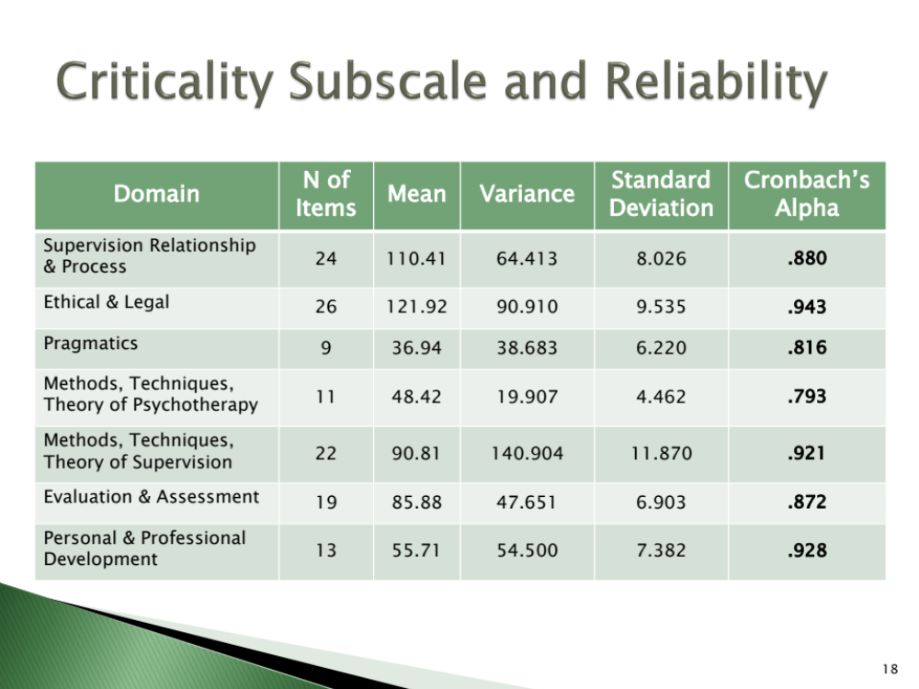

Slide 18
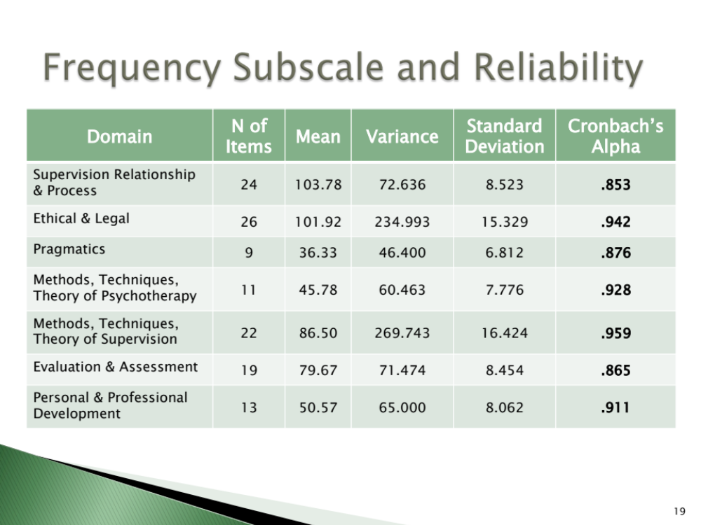

Slide 19
If you’d like more information, please contact lois@amftrb.org

