Slide 1


The Role of Regulatory Agencies in
Preventing Human Trafficking

Slide 2
What is BHEC and what does it do?
The Texas Behavioral Health Executive Council (“Council”) was created by the 86th Legislature in 2019 following consecutive Sunset reviews in 2017 and 2019.
The Council consists of the:
  Texas State Board of Examiners of Marriage and Family Therapists
  Texas State Board of Examiners of Professional Counselors
  Texas State Board of Examiners of Psychologists
  Texas State Board of Social Worker Examiners.

Slide 3
BHEC by the numbers…
Number of licensees (as of 6/30/22):
12,419 LCSWs 13,546 LMSWs 4,356 LBSWs 30,321 Total | 27,242 LPCs 5,013 LPC Associates 32,255 Total
3,870 LMFTs 632 LMFT Associates 4,502 Total | 6,164 Psychologists 922 LPAs 4,143 LSSPs 11,229 Total
Notes:
The lapse of unused funds was from $200K in salaries, $85K in travel funds, $6K for PSYPACT, and $6400 in misc. funds.

Slide 4
Human Trafficking in Texas
Human Trafficking affects both adults and children, men and women, and people from all parts of Texas, the United States, and around the world, and has been a major focus of the Texas legislature since at least 2007 (80th Legislature).
In 2019, Texas had the second-highest reported cases of human trafficking, according to the National Human Trafficking Hotline (Hotline Statistics | National Human Trafficking Hotline).
For the past several years, Texas has been one of the leading states in the number of reported human trafficking cases.

Slide 5
Human Trafficking in Texas
There are four major types of trafficking:
Adult Sex Trafficking - Trafficking of adults for sex by force, fraud, or coercion in strip clubs, brothels, massage parlors, street prostitution, or internet prostitution.
Adult Labor Trafficking - Trafficking adults for labor by force, fraud, or coercion into industries, such as agriculture, food service, manufacturing, domestic servitude, or hospitality.
Child Sex Trafficking - Trafficking children, under the age of 18, by any means into the commercial sex industry.
Child Labor Trafficking - Trafficking children, under the age of 18, by force, fraud or coercion into industries such as agriculture, food service, manufacturing, domestic servitude, or hospitality.

Slide 6
Human Trafficking in Texas
What is Texas doing to deter and punish human trafficking?
Trafficking of Persons in Texas starts out as a 2nd degree felony and can escalate to a 1st degree felony based upon various factors.
Second degree felonies carry a punishment range of 2-20 years in prison and up to a $10,000 fine.
First degree trafficking of persons carries a punishment range of 5-99 years or life in prison and up to a $10,000 fine.
Trafficking of persons on or within 1,000 feet of a school is a first degree felony with a punishment range of 25-99 years or life in prison and up to a $10,000 fine.
Since 2016, Texas has sentenced human traffickers to more than 750 years in prison.

Slide 7
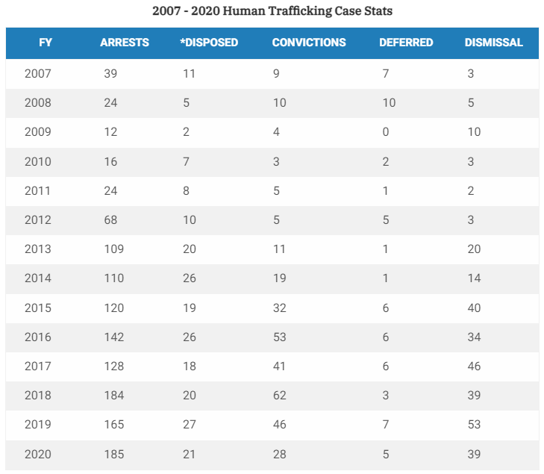
Human Trafficking in Texas

Slide 8
Human Trafficking Prevention Training
What is Texas doing to identify and intercede on behalf of victims at the regulatory level?
Licensees must undergo Human Trafficking Prevention Training in accordance with Section 116.02 of the Occupations Code (HB2059, 86th Legislature) as a condition of renewal.
The Council requires all new board and council members to watch a video published by the Office of the Attorney General entitled Be the One in the Fight against Human Trafficking.
A summary of Texas’ efforts to combat human trafficking can be found by clicking here.

Slide 9
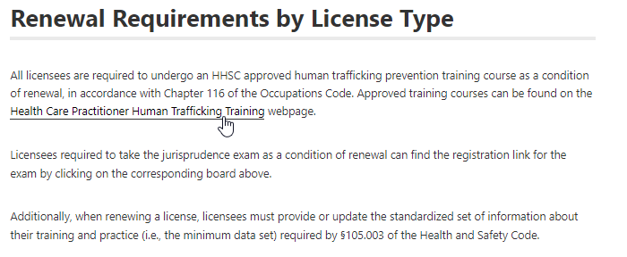
Human Trafficking Prevention Training
https://www.bhec.texas.gov/online-license-renewal-system/index.html

Slide 10

Human Trafficking Prevention Training
All human trafficking prevention training courses must be approved by the Texas Health and Human Services Commission (HHSC).
HHSC maintains a publicly available list of 90+ approved providers:

Slide 11
Human Trafficking Prevention Training
To be approved, a human trafficking prevention training course must cover 40 specific standards targeting key components of trafficking. Examples of these standards include:
Content must be evidence-based and free from factual errors;
Content must, at a minimum, count as 1 hour of continuing education;
Discuss the types of trafficking and the means by which they are carried out, e.g., force, fraud, coercion; and
Identify trafficker profiles and their recruitment techniques.
The complete list of training course standards can be viewed by clicking here.

Slide 12


Time for Q&A…

